Slide 1
Capsule Networks for NLP
Will Merrill
Advanced NLP
10/25/18

Slide 2
Capsule Networks: A Better ConvNet
Architecture proposed by Hinton as a replacement for ConvNets in computer vision
Several recent papers applying them to NLP:
Zhao et al., 2018
Srivastava et al., 2018
Xia et al. 2018
Goals:
Understand the architecture
Go through recent papers
Notes:
“Feel free to stop me for questions at any time”

Slide 3
What’s Wrong with ConvNets?

Slide 4

Convolutional Neural Networks
Cascade of convolutional layers and max-pooling layers
Convolutional layer:
Slide window over image and apply filter
https://towardsdatascience.com/build-your-own-convolution-neural-network-in-5-mins-4217c2cf964f

Slide 5

Max-Pooling
ConvNets use max-pooling to move from low-level representations to high-level representations
https://computersciencewiki.org/index.php/Max-pooling_/_Pooling
Notes:
Particularly important for ConvNets

Slide 6
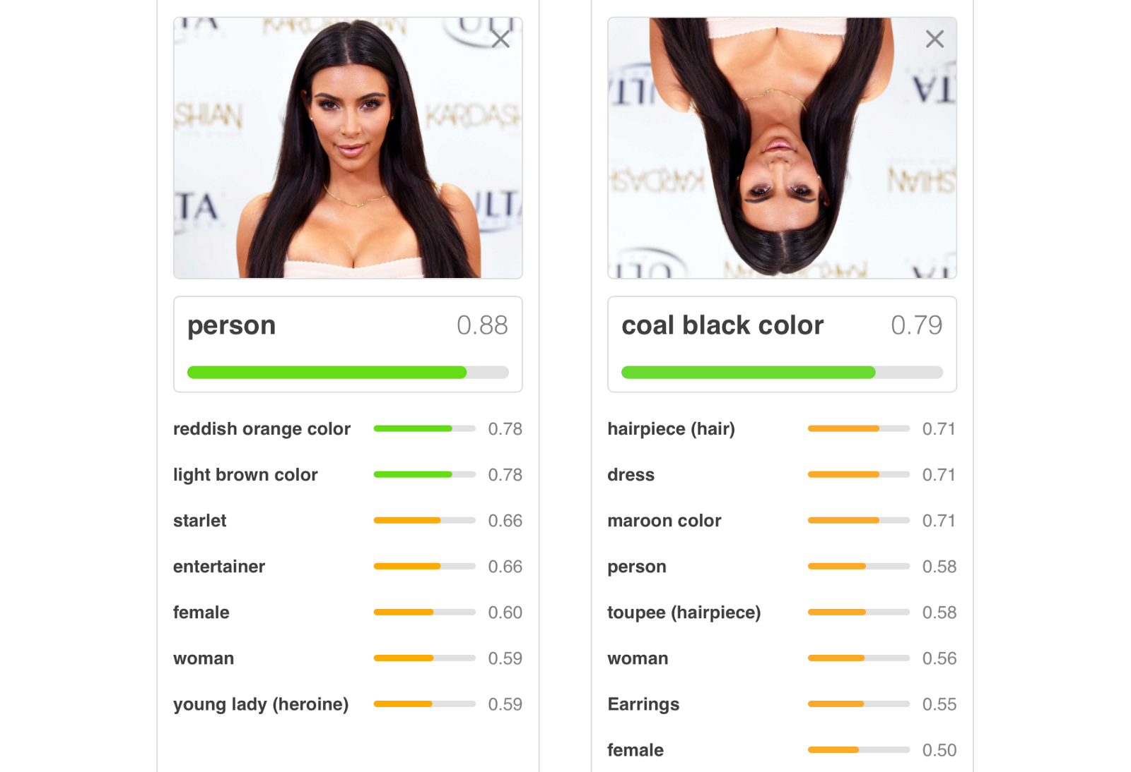
Problem #1: Transformational Invariance
We would like networks to recognize transformations of the same image
Requires huge datasets of transformed images to learn transformations of high-level features
https://medium.freecodecamp.org/understanding-capsule-networks-ais-alluring-new-architecture-bdb228173ddc
Notes:
Rotating Kim Kardashian breaks the classifier!

Slide 7
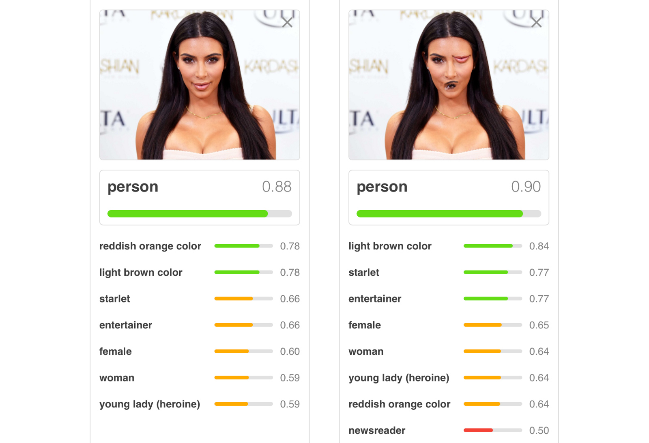
Problem #2: Feature Agreement
Max-pooling in images loses information about relative position
More abstractly, lower level features do not need to “agree”
https://medium.freecodecamp.org/understanding-capsule-networks-ais-alluring-new-architecture-bdb228173ddc

Slide 8
Capsule Network Architecture

Slide 9
Motivation
We can solve problems #1 and #2 by attaching “instantiation parameters” to each filter
ConvNet: Is there a house here?
CapsNet: Is there a house with width w and rotation r here?
Each filter at each position has a vector value instead of a scalar
This vector is called a capsule

Slide 10
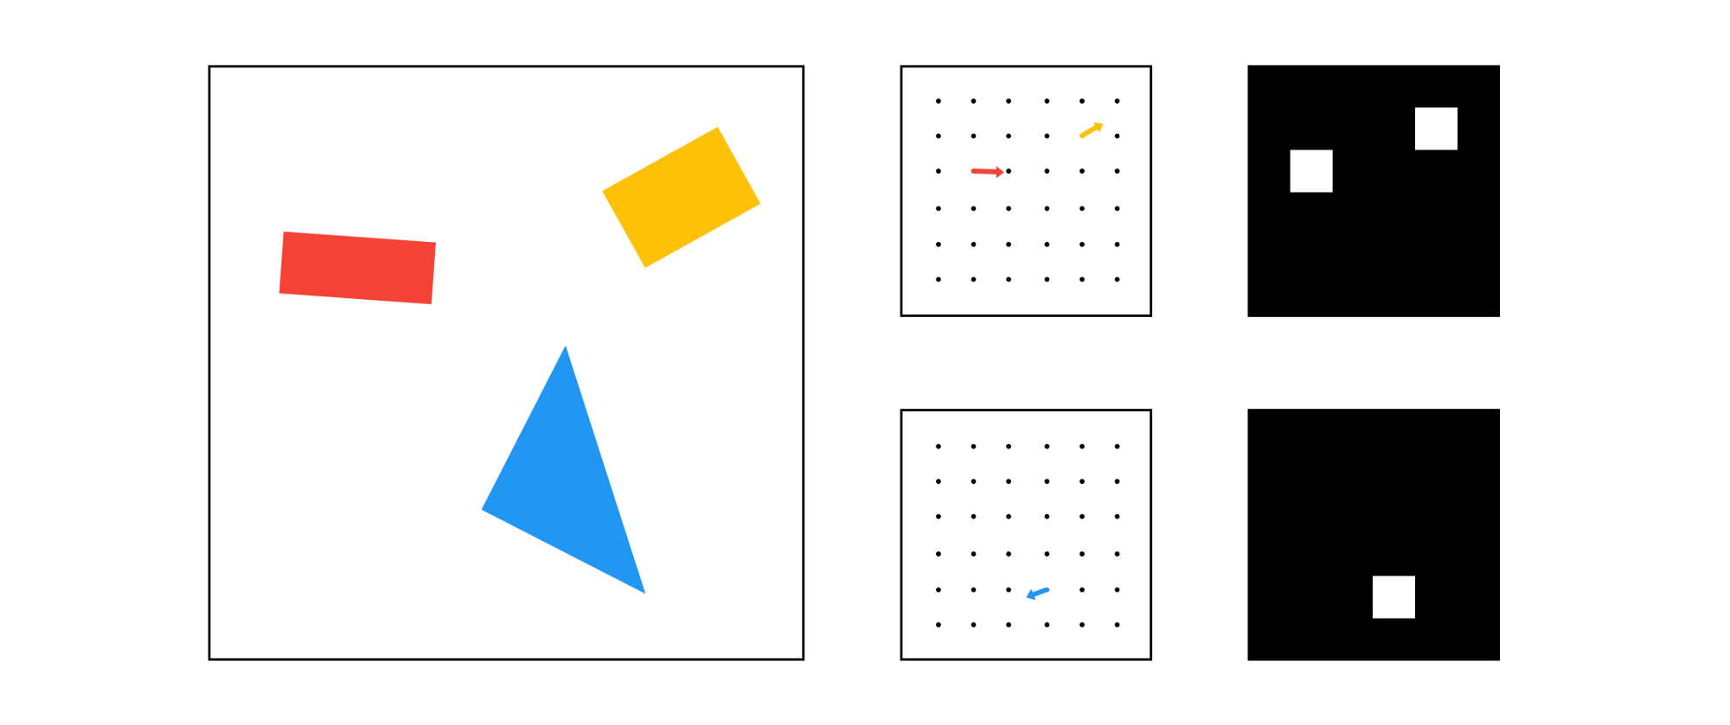
Capsules
The value of capsule i at some position is a vector u_{i}
|u_{i}| ∊ (0, 1) gives the probability of existence of feature i
Direction of u_{i} encodes the instantiation parameters of feature i
https://medium.freecodecamp.org/understanding-capsule-networks-ais-alluring-new-architecture-bdb228173ddc
Notes:
Left is capsule representation
Right is convolution representation

Slide 11
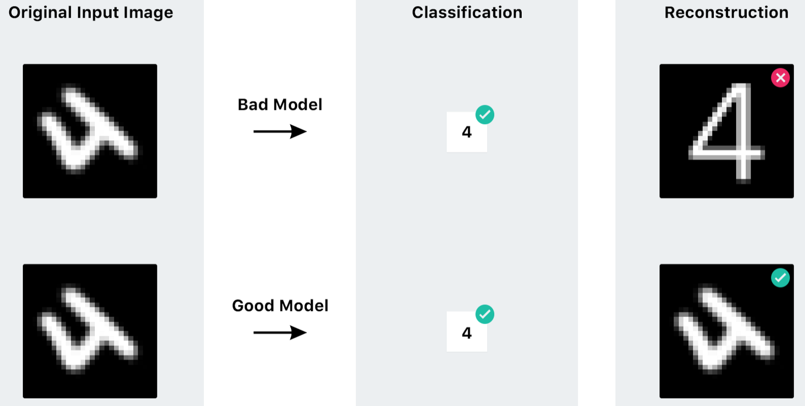
Capsules (Continued)
https://medium.freecodecamp.org/understanding-capsule-networks-ais-alluring-new-architecture-bdb228173ddc
Notes:
In a good capsule model, instantiation parameters let you do things like preserve rotation for building a reconstruction

Slide 12
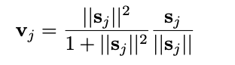
Capsule Squashing Function
New squashing function which which puts magnitude of vector into (0, 1)
Referred to in literature as g(..) or squash(..)
Will be useful later on
Sabour et al., 2017

Slide 13
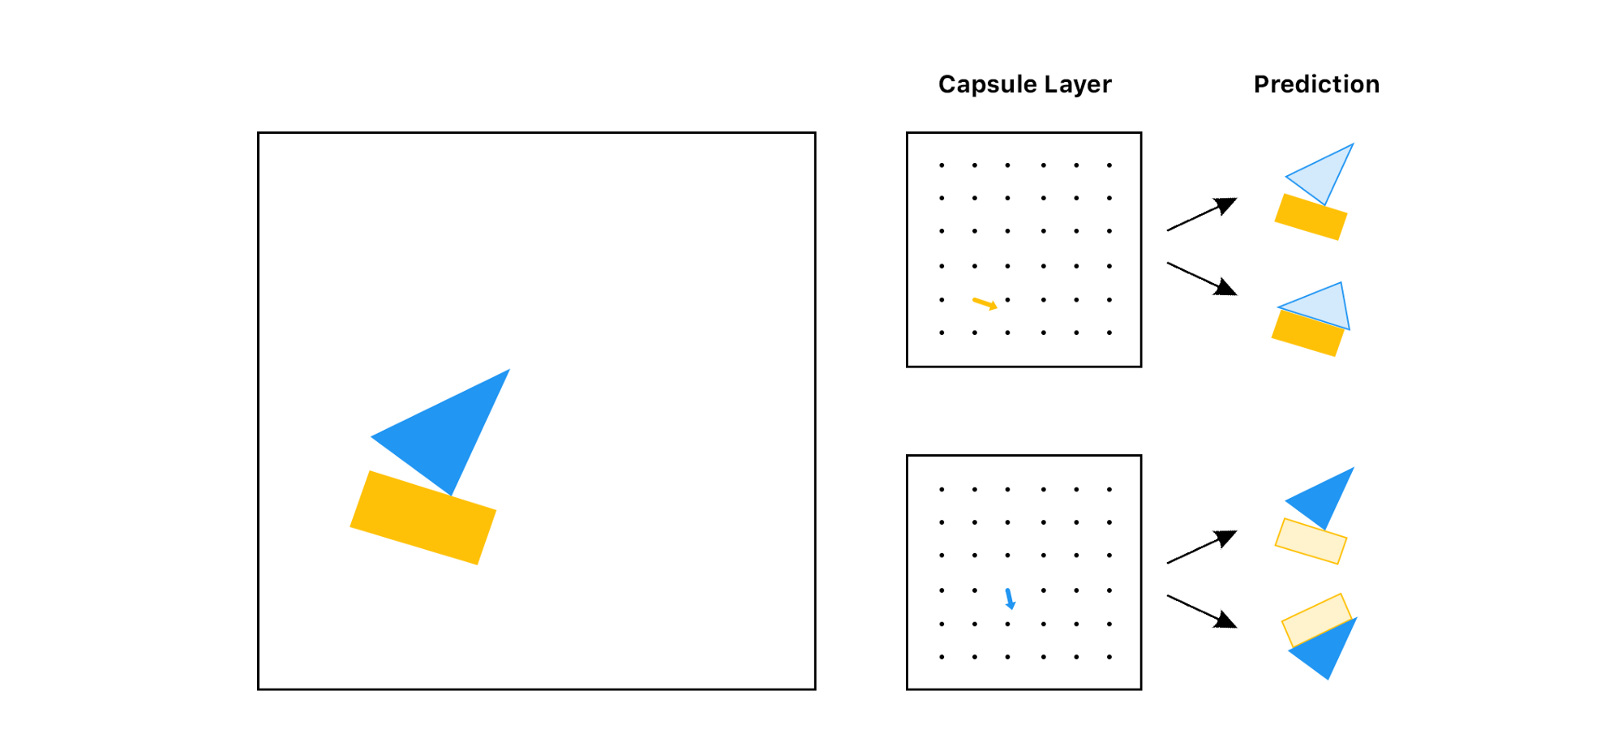
Routing by Agreement
Capture child-parent relationships
Combine features into higher-level ones only if the lower-level features “agree” locally
Is this picture a house or a sailboat?
https://medium.freecodecamp.org/understanding-capsule-networks-ais-alluring-new-architecture-bdb228173ddc
Notes:
How do we connect capsule layers?
Relevant to the misplaced mouth problem

Slide 14
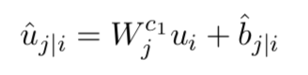
Routing: Vote Vectors
Learned transformation for what information should be “passed up” to the next layer
Models what information is relevant for abstraction/agreement
û_{j|i} denotes the vote vector from capsule i to capsule j in the next layer
Zhao et al., 2018

Slide 15
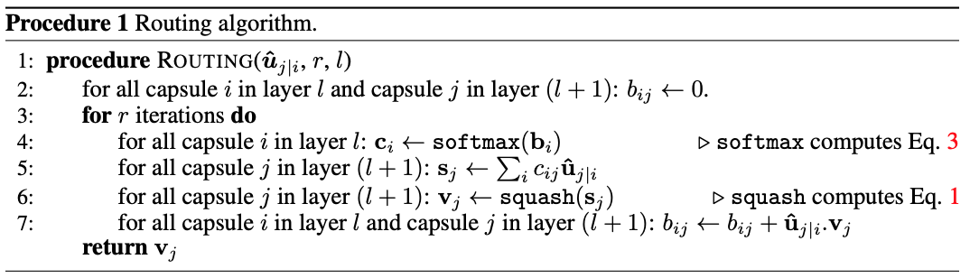
Routing: Dynamic Routing Algorithm
Unsupervised iterative method for computing routing
No parameters (But depends on vote vectors)
Used to connect capsule layers
Compute next layer of capsules {v_{j}} from vote vectors
Sabour et al., 2017
Notes:
Iterative method of estimating log likelihoods of connection
Compute capsule in the next layer as weighted some of vote vectors
How we connect capsule layers

Slide 16
Types of Capsule Layers
Primary Capsule Layer: Convolutional output ➝ capsules
Convolutional Capsule Layer: Local capsules ➝ capsules
Feedforward Capsule Layer: All capsules ➝ capsules
Notes:
Different layer types use routing in different ways.
Just like different kinds of matrix multiplications give us different NN layers
TODO: also talk about orphan category
Goal: 70 slides

Slide 17
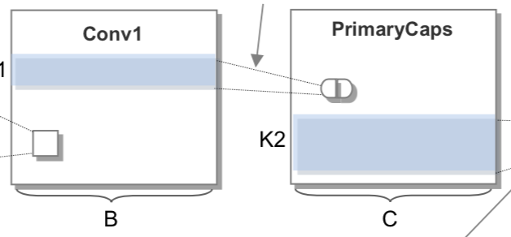
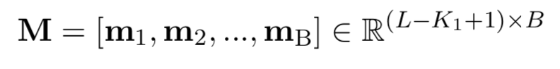
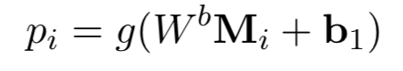
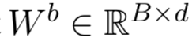
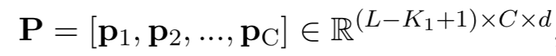
Primary Capsule Layer
Convolutional output ➝ capsules
Create C capsules from B filters
Convolution output with B filters:
Transform each row of features:
Collect C d-dimensional capsules:
Zhao et al., 2018
Notes:
M is the output of a 1D convolution
Make this into a 3D tensor where each filter value is a capsule (vector)

Slide 18
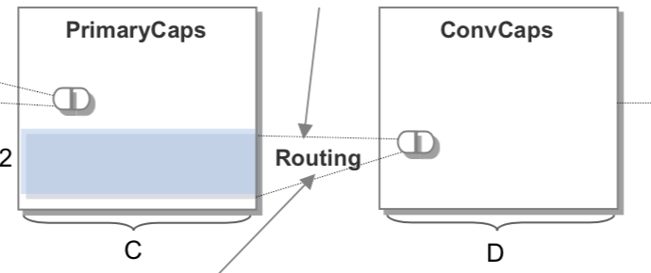
Convolutional Capsule Layer
Local capsules in layer #1 ➝ capsules in layer #2
Route a sliding window of capsules in previous layer into capsules in next layer

Slide 19
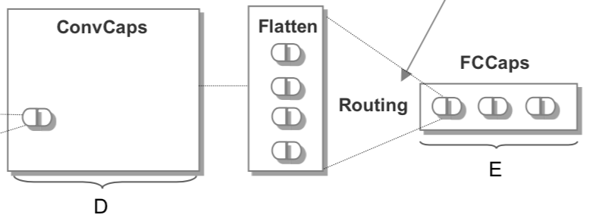
Feedforward Capsules Layer
All capsules in layer #1 ➝ capsules in layer #2
Flatten all capsules in layer #1 into a vector
Route from this vector of capsules into new capsules
Notes:
Like the fully connected classification layer at the end of the convolutional network

Slide 20
Margin Loss
Identify each output capsule with a class
Classification loss for capsules
Calculate on output of feedforward capsule layer
Ensures that the capsule vector for the correct class is long (|v| ≈ 1)
Sabour et al., 2017

Slide 21
Investigating Capsule Networks with Dynamic Routing for Text Classification
Zhao, Ye, Yang, Lei, Zhang, Zhao 2018

Slide 22
Main Ideas
Develops capsule network architecture for text classification tasks
Achieves state-of-the-art performance on single-class text classification
Capsules allow transferring single-class classification knowledge to multi-class task very well

Slide 23
Text Classification
Read text and classify something about the passage
Sentiment analysis, toxicity detection, etc.

Slide 24
Multi-Class Text Classification
Document can be labeled as multiple classes
Example: In toxicity detection, Toxic and Threatening

Slide 25
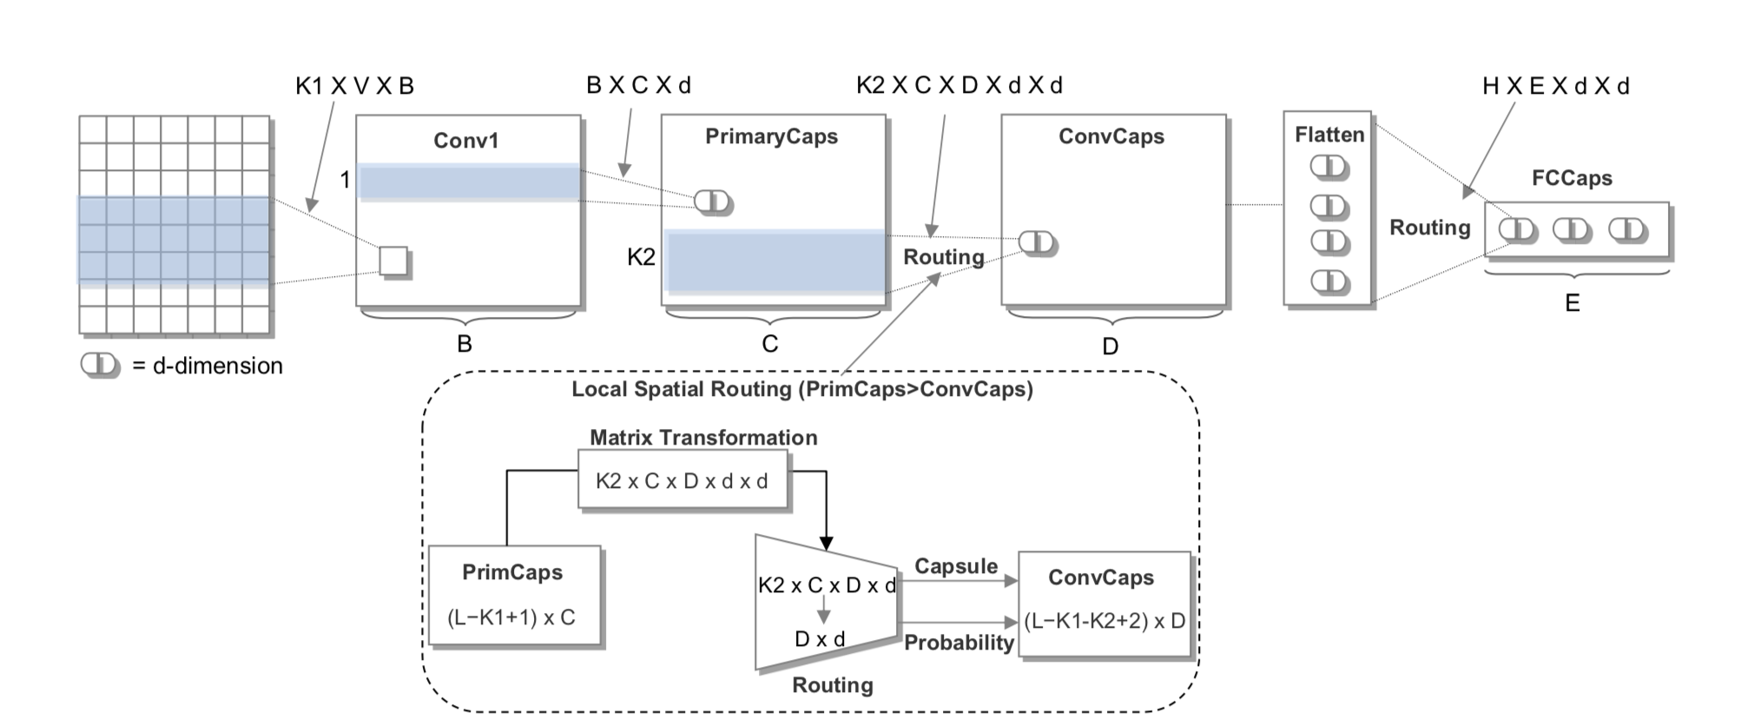
Text Classification Architecture

Slide 26
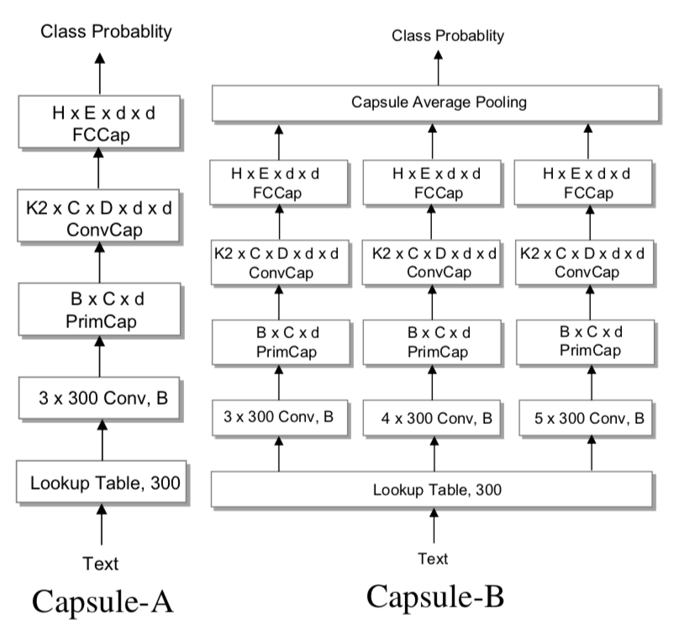
Architectural Variants
Capsule-A: One capsule network
Capsule-B: Three capsule networks that are averaged at the end

Slide 27
Orphan Category
Add a capsule that corresponds to no class to the final layer
Network can send words unimportant to classification to this category
Function words like the, a, in, etc.
More relevant in the NLP domain than in images because images don’t have a “default background”

Slide 28
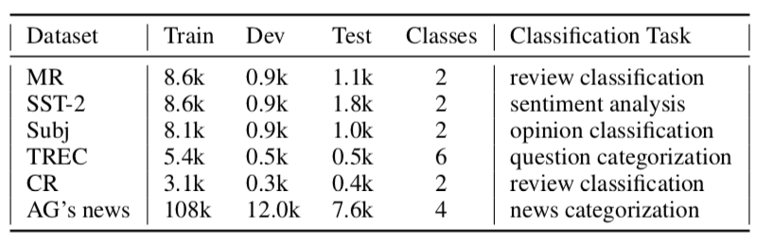
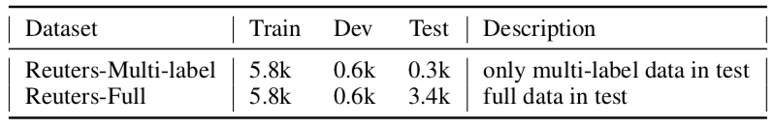
Datasets
Single-Label
Multi-Label
Notes:
Single-class: One correct label per example
Reuters-Multi-label: Single-class training data, multi-class test data
Reuters-Full: Single-class training data, mixed test data

Slide 29
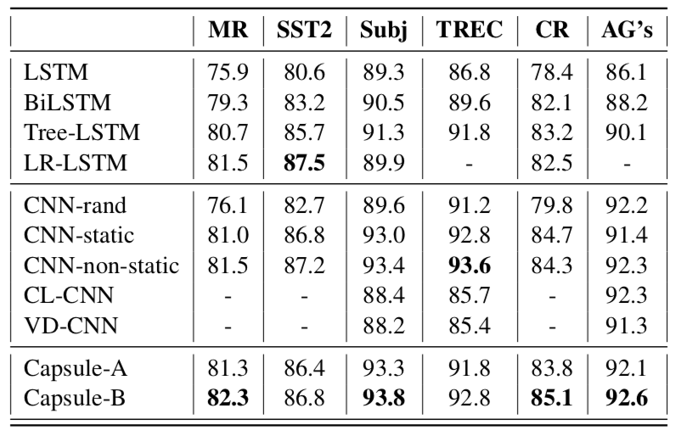
Single-Class Results

Slide 30
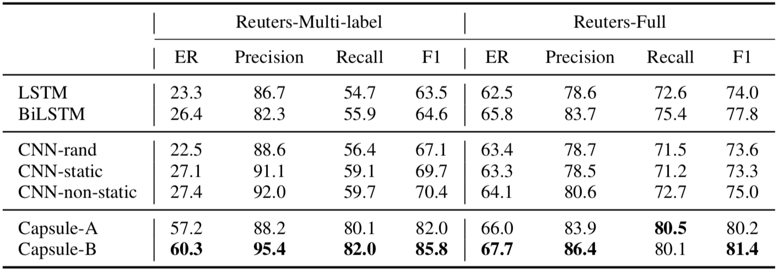
Multi-Class Transfer Learning Results

Slide 31
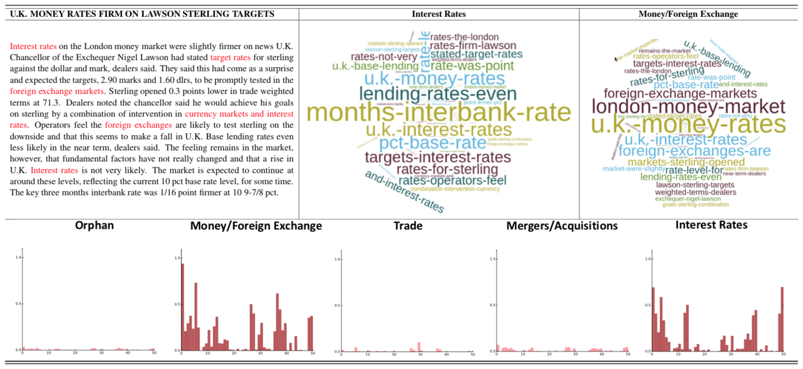
Connection Strength Visualization
Notes:
Bottom graphs shows connection strengths from primary capsules to fully connected capsules
Top word-cloud shows top trigrams for each class
Interpretability

Slide 32
Discussion
Capsule network performs strongly on single-class text-classification
Capsule model transfers effectively from single-class to multi-class domain
Richer representation
No softmax in last layer
Useful because multi-class data sets are hard to construct (exponentially larger than single-class data sets)

Slide 33
Identifying Aggression and Toxicity in Comments Using Capsule Networks
Srivastava, Khurana, Tewari 2018

Slide 34
Main Ideas
Develop end-to-end capsule model that outperforms state-of-the-art models for toxicity detection
Eliminate need for pipelining and preprocessing
Performs especially well on code-mixed comments (comments switching between English and Hindi)

Slide 35
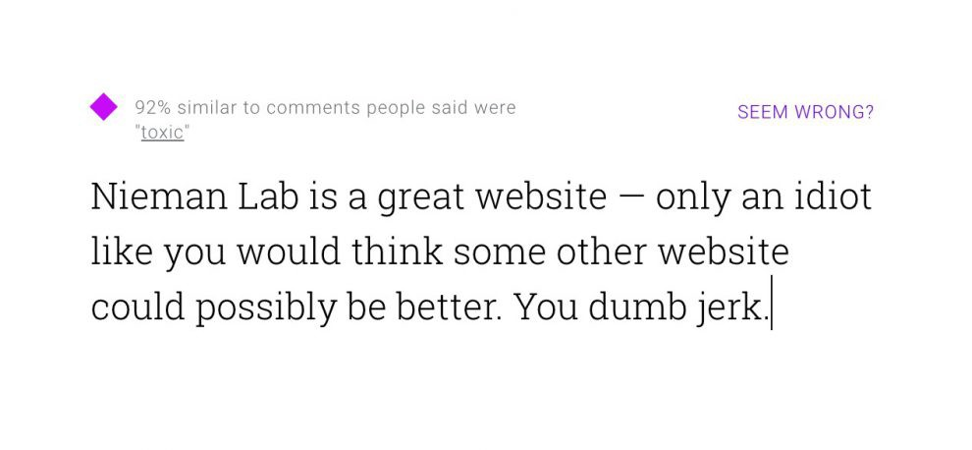
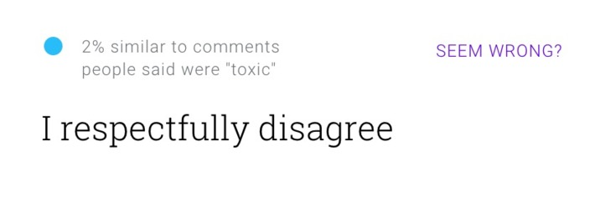
Toxicity Detection
Human moderation of online content is expensive – useful to do algorithmically
Classify comments as toxic, severe toxic, identity hate, etc.

Slide 36
Challenges in Toxicity Detection
Out-of-vocabulary words
Code-mixing of languages
Class imbalance

Slide 37
Why Capsule Networks?
Seem to be good at text classification (Zhao et al., 2018)
Should be better at code-mixing than sequential models (build up local representations)

Slide 38
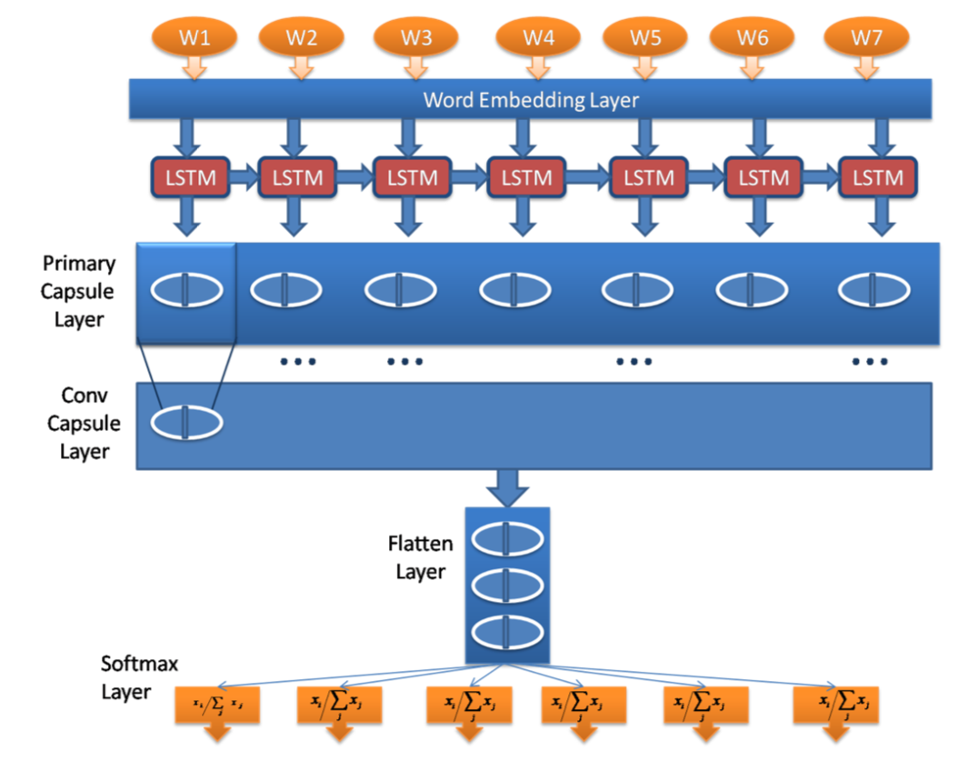
Architecture
Very similar to architecture to Zhao et al.
Feature extraction convolutional layer replaced by LSTM
Standard softmax layer instead of margin loss

Slide 39
Focal Loss
Loss function on standard softmax output
Used to solve the class imbalance problem
Weights rare classes higher than cross-entropy

Slide 40
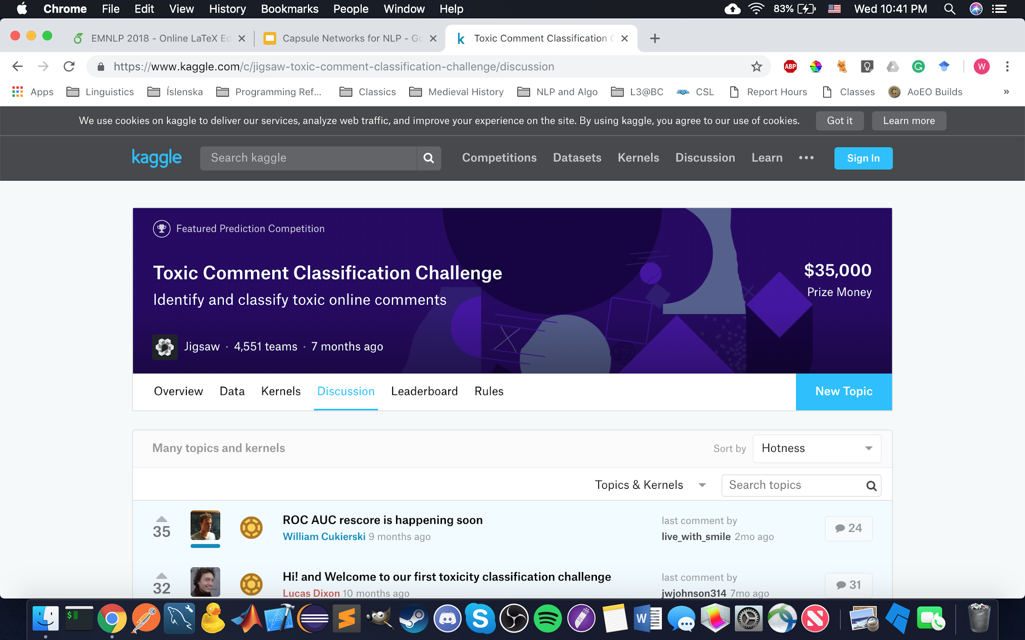
Datasets
Kaggle Toxic Comment Classification
English
Classes: Toxic, Severe Toxic, Obscene, Threat, Insult, Identity Hate
First Shared Task on Aggression Identification (TRAC)
Mixed English and Hindi
Classes: Overtly Aggressive, Covertly Aggressive, Non-Aggressive
https://www.kaggle.com/c/jigsaw-toxic-comment-classification-challenge/discussion

Slide 42
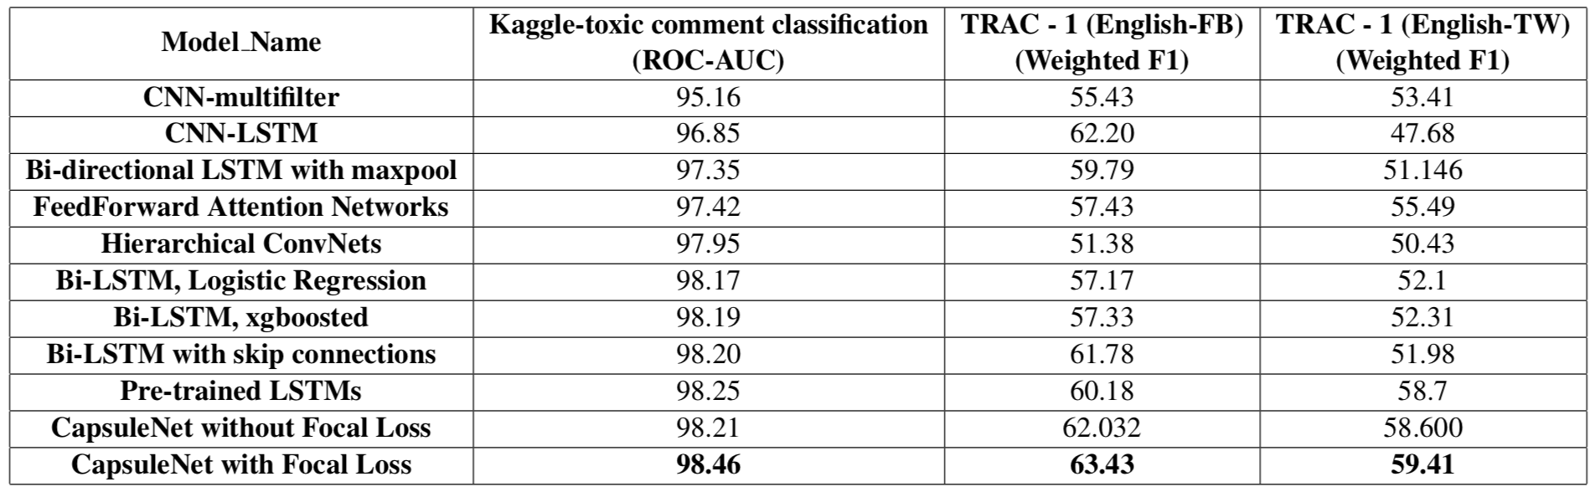
Results
Notes:
Increase in performance is larger on the TRAC dataset

Slide 43
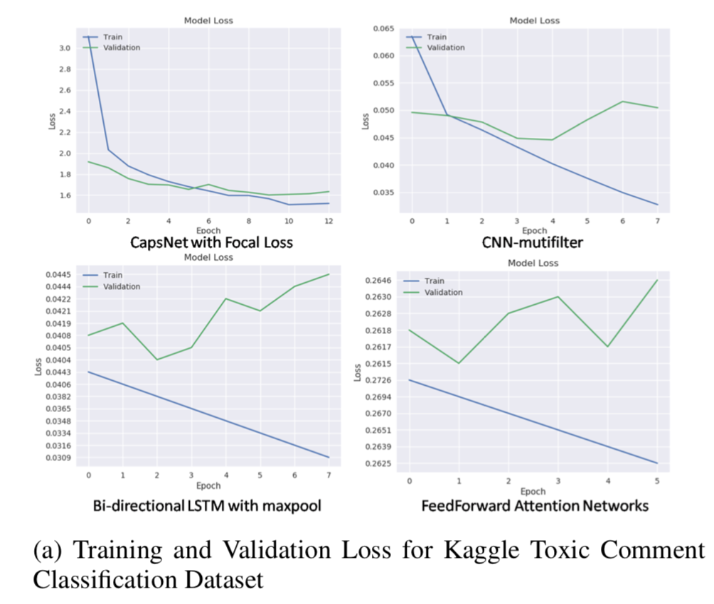
Training/Validation Loss
Training and validation loss stayed much closer for the capsule model
⇒ Avoids overfitting

Slide 44
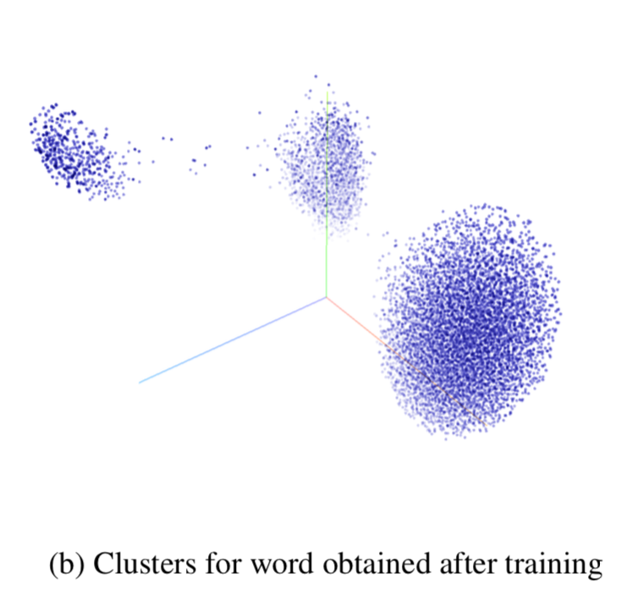
Word Embeddings on Kaggle Corpus
Three clear clusters:
Neutral words
Abusive words
Toxic words + place names

Slide 45
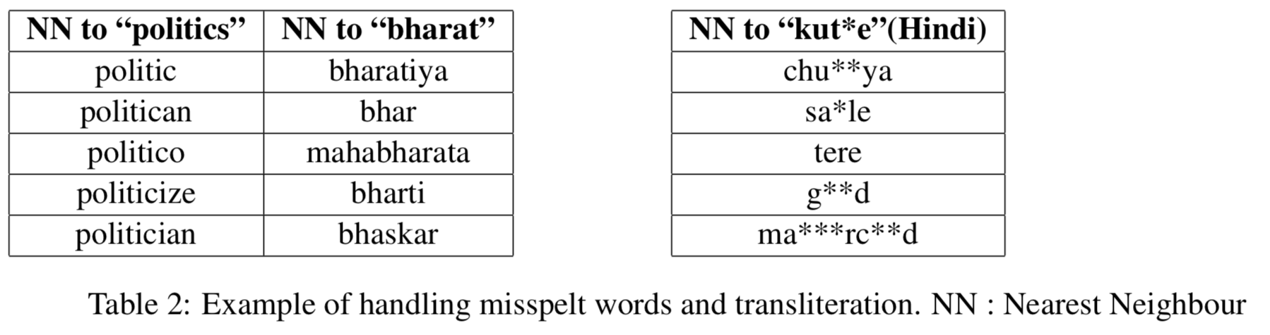
OOV Embeddings
Out of vocabulary words randomly initialized
Converge to accurate vectors

Slide 46
Discussion
The novel capsule network architecture performed the best on all three datasets
No data preprocessing done
Avoids overfitting
Local representations lead to big gains in mixed-language case
Notes:
On the Kaggle dataset, how much was due to capsule architecture versus focal loss?

Slide 47
Zero-shot User Intent Detection via Capsule Neural Networks
Xia, Zhang, Yan, Chang, Yu 2018
Notes:
TODO:
flesh out this paper
number of parameters

Slide 48
Main Ideas
Capsule networks extract and organize information during supervised intent detection
These learned representations can be effectively transferred to the task of zero-shot intent detection

Slide 49
User Intent Detection
Text classification task for question answering and dialog systems
Classify which action a user query represents out of a known set of actions
GetWeather, PlayMusic

Slide 50
Zero-Shot User Intent Detection
Training set with known set of intents
GetWeather, PlayMusic
Test set has unseen “emerging” intents
AddToPlaylist, RateABook
Transfer information about known intents to new domain of emerging intents

Slide 51
What Signal is There?
Embedding of the string name of the unknown and known intents
Output capsules for known intents
Can combine these two things to do zero-shot learning

Slide 52
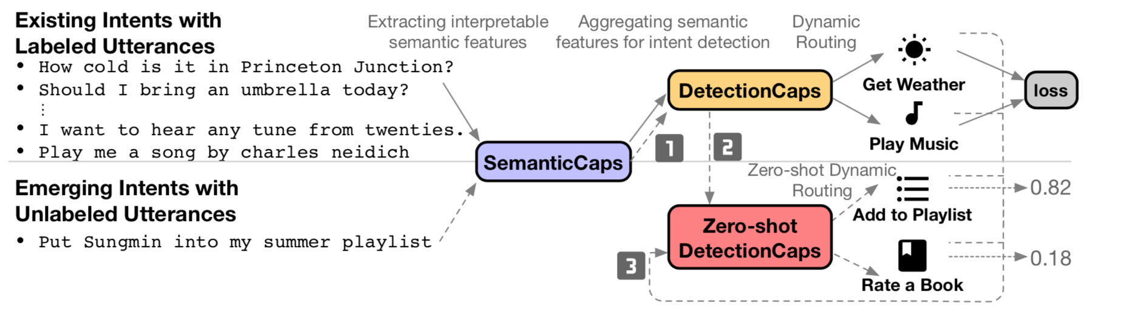
Architecture
Network trained on known intents
Extension for zero-shot inference
Notes:
SemanticCaps: Extract semantic features from input
DetectionCaps: Convert semantic features to known intents
Zero-shot DetectionCaps: Transfer information about known intents to emerging intents
(More on that later)

Slide 53
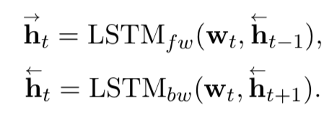
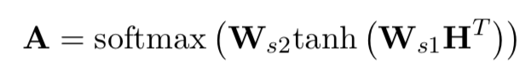
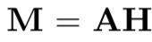
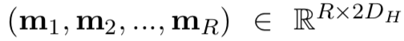
SemanticCaps Layer
Extract features using self-attention LSTM
Combine to get H
Self-attention weights
M is the extracted features

Slide 54
DetectionCaps Layer
Standard convolutional capsule layer → feedforward capsule layer

Slide 55
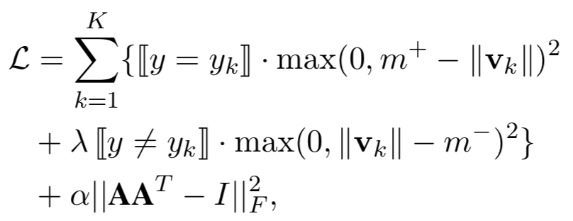
Loss During Training
Normal max-margin loss + regularization
Regularization incentivizes semantic capsules to capture different features
Regularization controlled by hyperparameter α
Max-margin loss
Regularization term
Notes:
TODO: Add more about SemanticCaps
L2 regularization over self-attention matrix

Slide 56
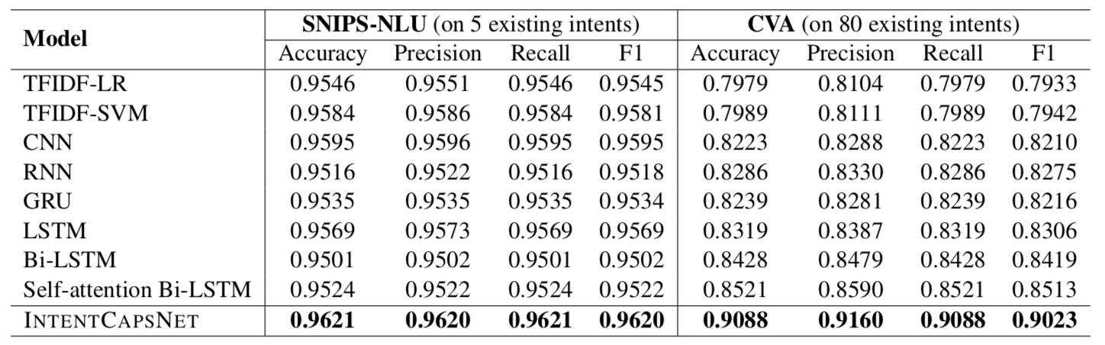
Intent Detection Results

Slide 57
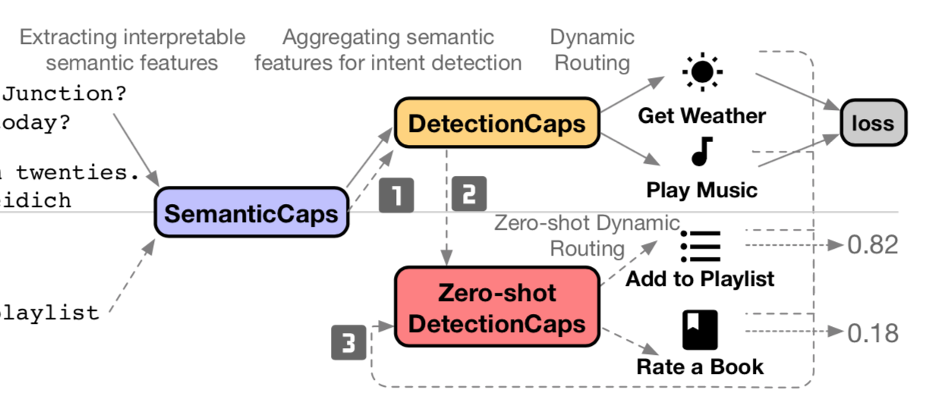
Architecture Revisited
Goal: Use predicted capsules for known intents for zero-shot inference

Slide 58
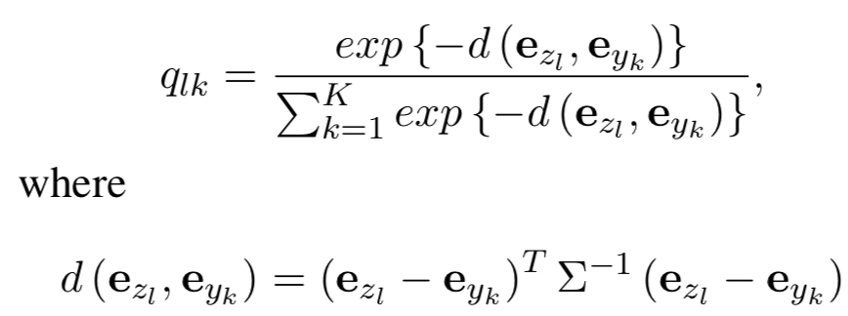
Generalizing to Emerging Intents
Build similarity matrix between existing intents and emerging intents based on embeddings for intent names:
Notes:
Define distance metric over intents
Convert distances to similarities/distribution in matrix form

Slide 59
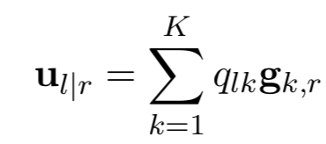
Classifying Emerging Intents
Goal is to get prediction vector for emerging intent l
Have vote vectors g_{k,r} from known intent classification
Represent vote vector for emerging intent as weighted sum of known intents:
Use dynamic routing to get an activation capsule n_{l} for each emerging intent
Pick the n_{l} with largest magnitude
Notes:
Really clever architecture
Takes advantage of this fact that weights are removed from routing
Can create a “layer” of the network with heuristically calculated/frozen parameters

Slide 60
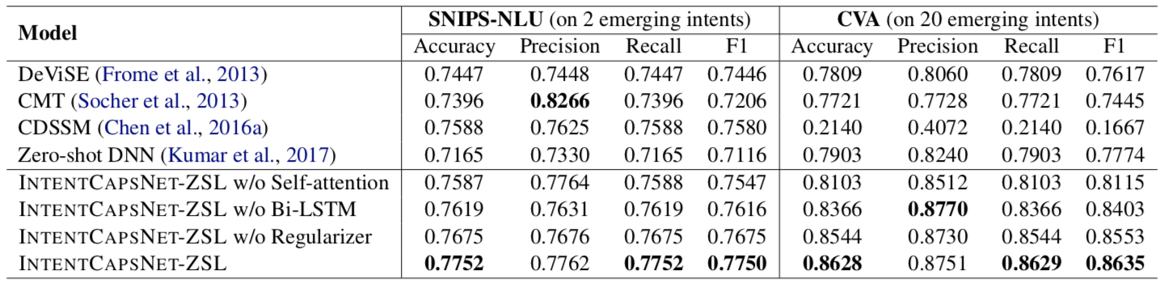
Zero-Shot Intent Detection Results

Slide 61
Discussion
Representational power of capsule network can be leveraged for zero-shot learning
Interesting regularizations and architectural extensions for capsule networks

Slide 62
Conclusion
Capsule representations encode “instantiation parameters” of features
Papers follow a standard CapsNet architecture for text classification:
Features Extraction (ConvNet or LSTM)
Primary Capsule Layer
Convolutional Capsule Layer
Classification (Margin or softmax)
Capsule representations can be leveraged for transfer/zero-shot learning

Slide 63
Discussion Questions
What is powerful about capsule representations?
Are capsule networks good for NLP, or are they just good for vision?
Why has NLP capsule research focused on text classification tasks?
What are some other NLP tasks that capsule networks could be applied to?
What other advanced architectures could be useful in NLP?

Slide 64
Other Papers
Sara Sabour, Nicholas Frosst, and Geoffrey E Hinton. 2017. Dynamic routing between capsules. In Advances in Neural Information Processing Systems, pages 3859–3869.

Slide 65
Other Materials
https://medium.freecodecamp.org/understanding-capsule-networks-ais-alluring-new-architecture-bdb228173ddc
https://medium.com/ai%C2%B3-theory-practice-business/understanding-hintons-capsule-networks-part-i-intuition-b4b559d1159b

